Slide 1

Automated reports using R and RStudio
Martín Sielfeld
MSc in Economics, Adolfo Ibáñez University
GitHub repository

Slide 2
INDEX
What’s R?
Automated reports
Rmarkdown
Example

Slide 3
What’s R?

Slide 4

R language
Free software environment for statistical computing and graphics.
Used worldwide, such as Python, Stata, SQL, among others.
Works on Windows, Mac or Linux.
Rstudio, a free integrated development environment (IDE) to help you work in R.
Many tools and packages.

Slide 5
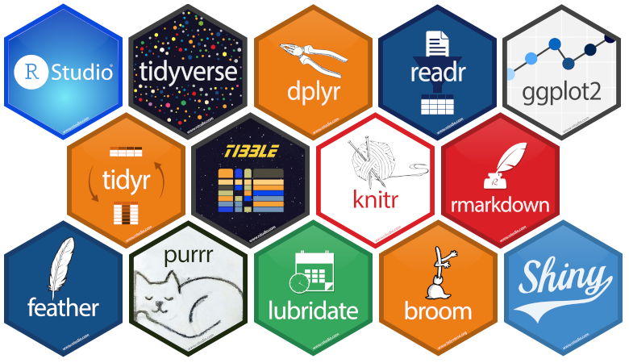
R packages
Data cleaning, manipulation and merging (data.table, dplyr, broom, tidyr)
Statistic and regression analysis (fixest, forecast, mlogit)
Classification (caret)
Web scrapping (rvest, rcrawler)
Blog and app design (blogdown, Shiny)
Creation of Word, PowerPoint and Excel files (rmarkdown).
Ploting (ggplot2, plotly, gapminder, highcharter)

Slide 6
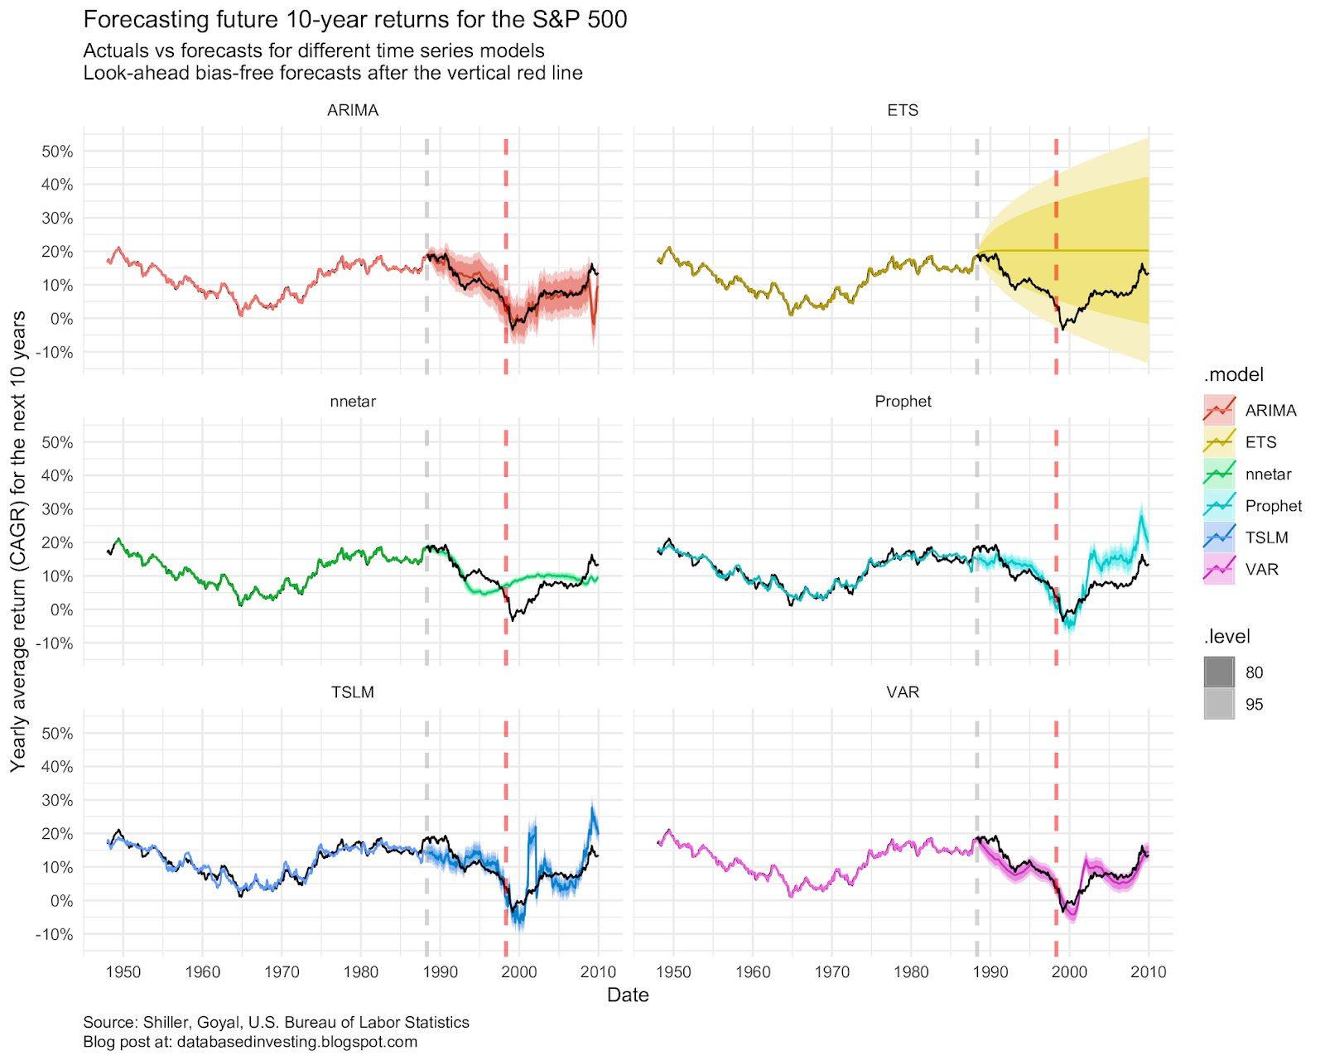
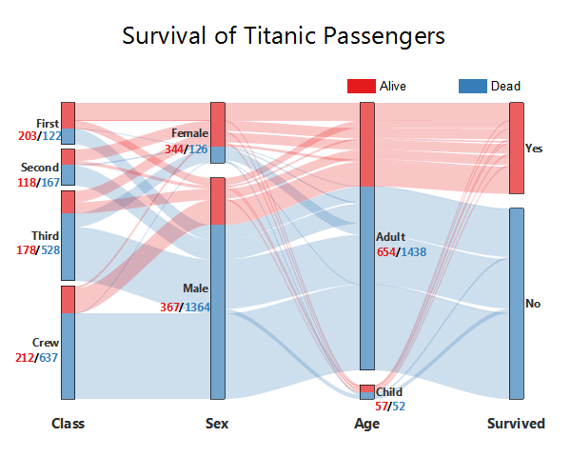
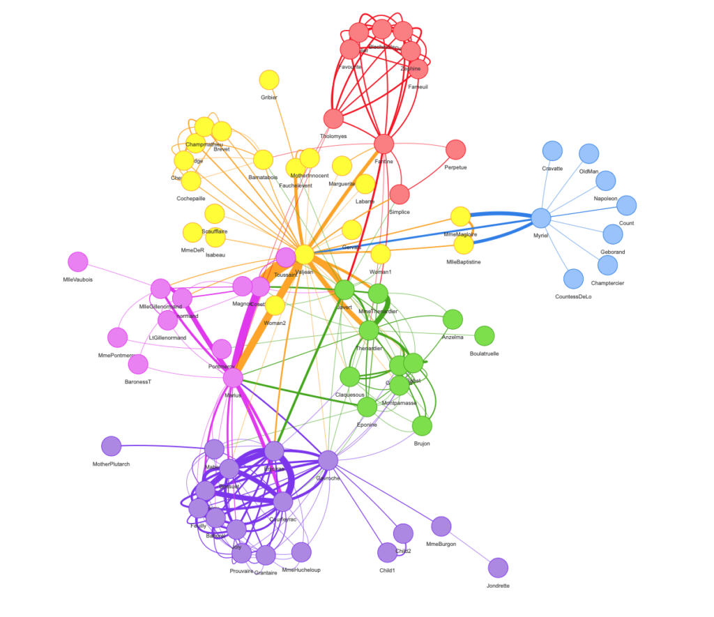
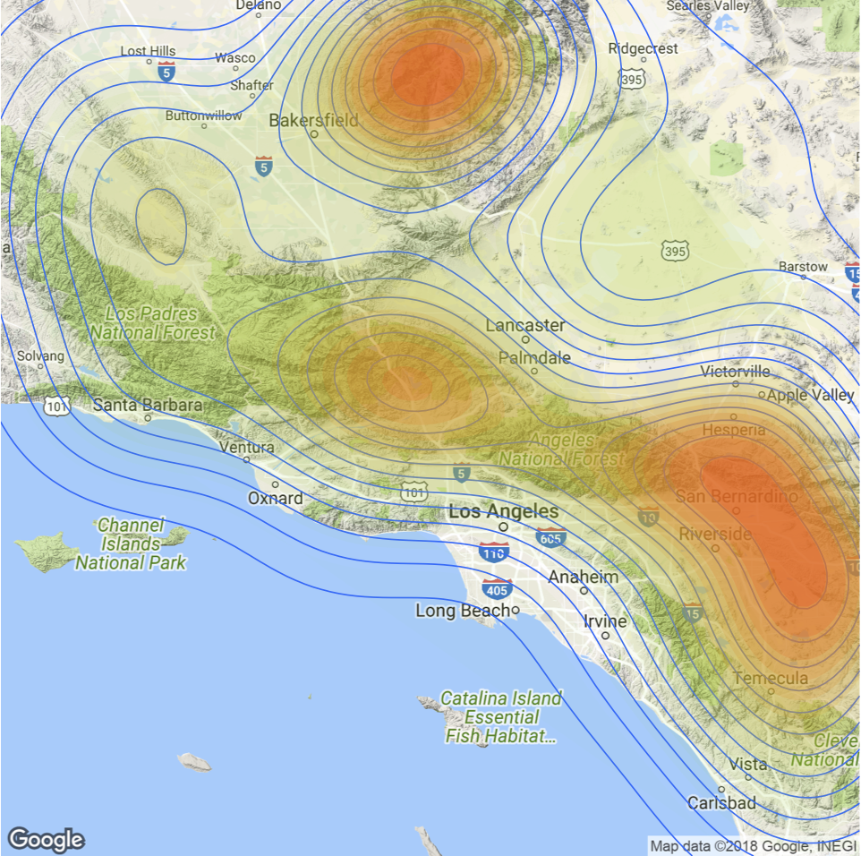
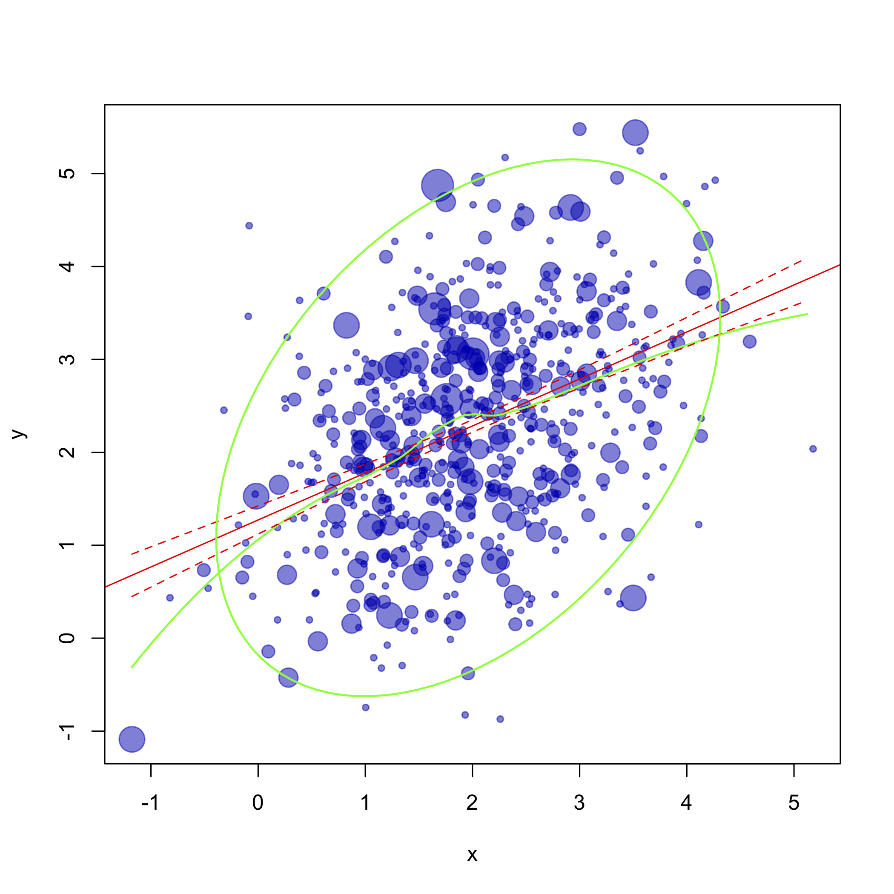
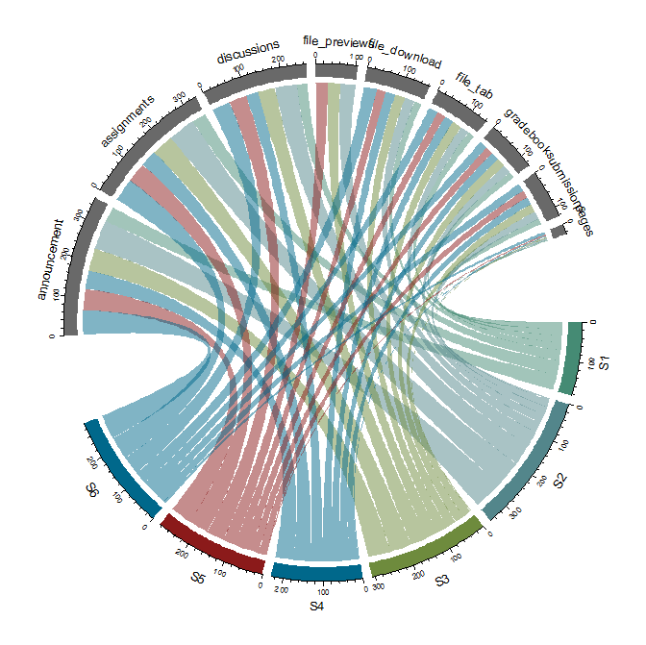
Visualization using r

Slide 7
Automated reports

Slide 8
Why automatize my work?
Reduce time on repetitive things (coding).
Work is reproducible.
Allows to create files for many years/groups in minutes.
Requirements:
Frequent data
Standardized (or almost) format
Large amounts of data

Slide 9
What can we automate?
Plots: do you use the same plots for each report?
Tables: do these tables include the same information in each report?
Text: does a part of a text follow a pattern? (numbers, words)
Example:
There are 7,073,193 workers in April-2021, 1,893,345 less than April-2019. The decrease in workers was the result of prolonged lockdowns.
Standardized text (does not change over time or group)
Automatized text (does change over time or group)
Context (not always the same, so is not possible to automate it)

Slide 10
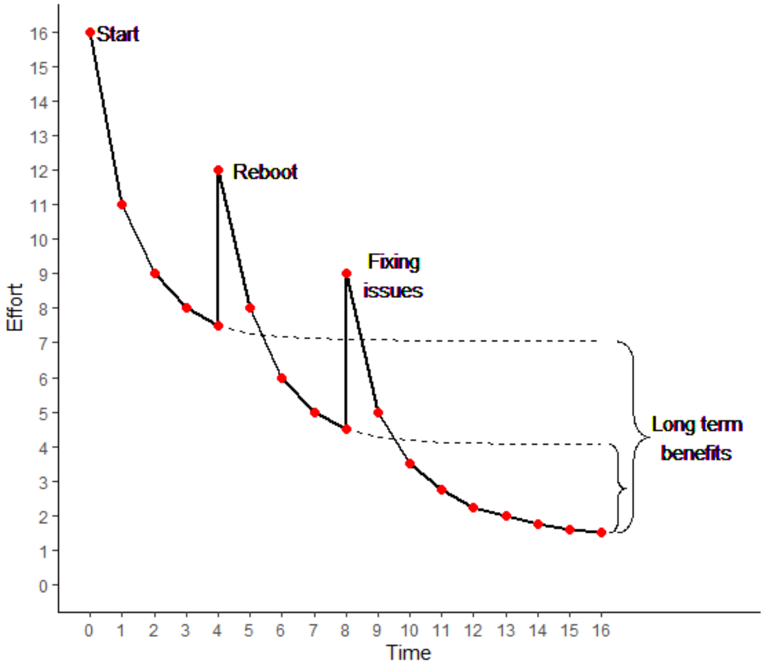
The process
It’s always a good idea to automatize a process?
No
Learn about the tools you’re going to use (packages, program).
Learn about the data.
Does the long-term benefits justify all the initial work?
Is all the work automatable?

Slide 11
rmarkdown

Slide 12
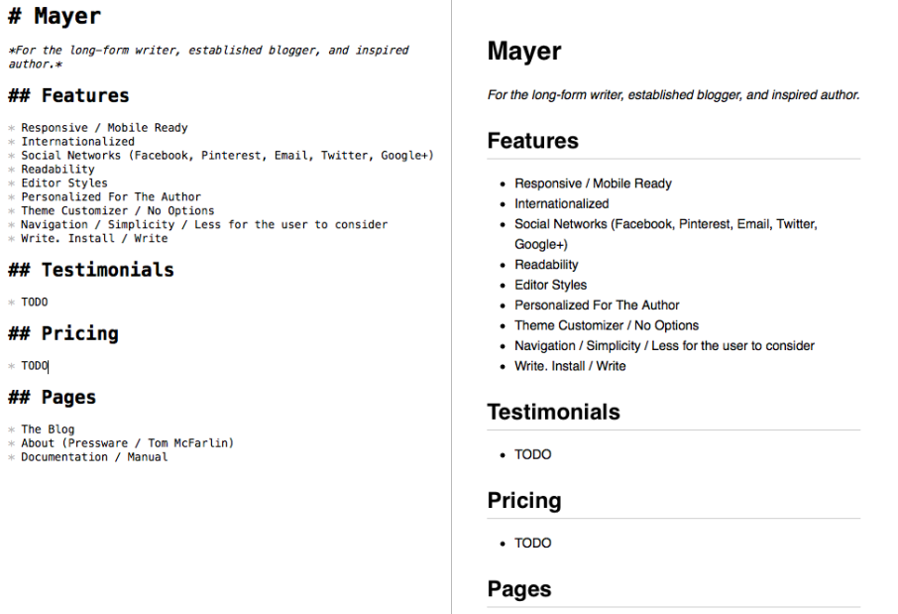
markdown
Lightweight markup language for creating formatted text using a plain-text editor.
Has his own standardized coding language.
Supports HTML.
Widely used in:
Blogging
Instant messaging
Online forums
Collaborative software
Readme files (GitHub)

Slide 13
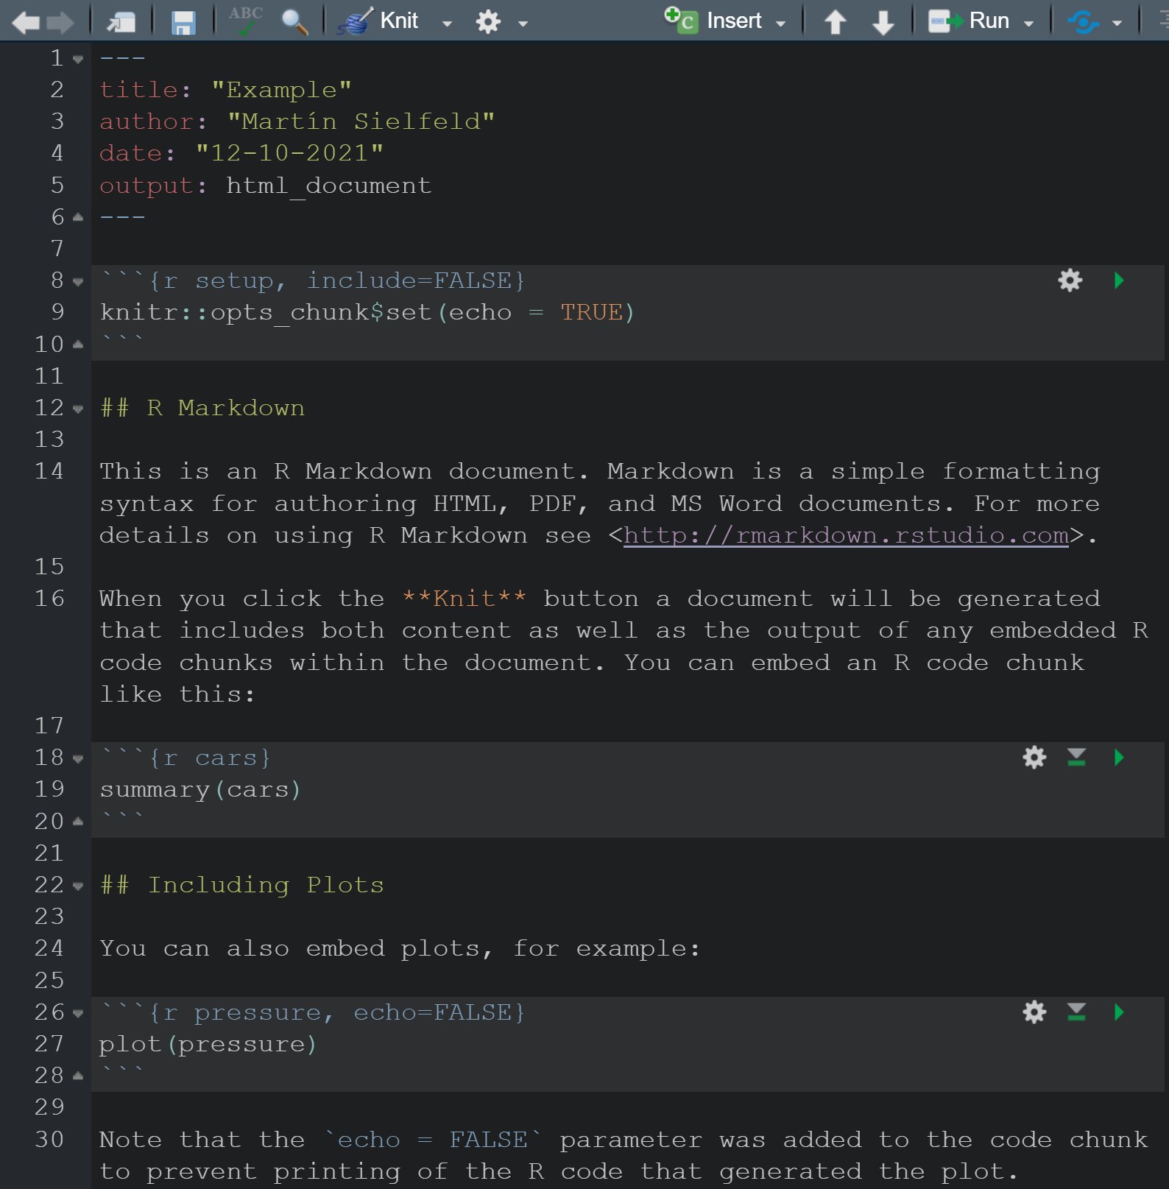
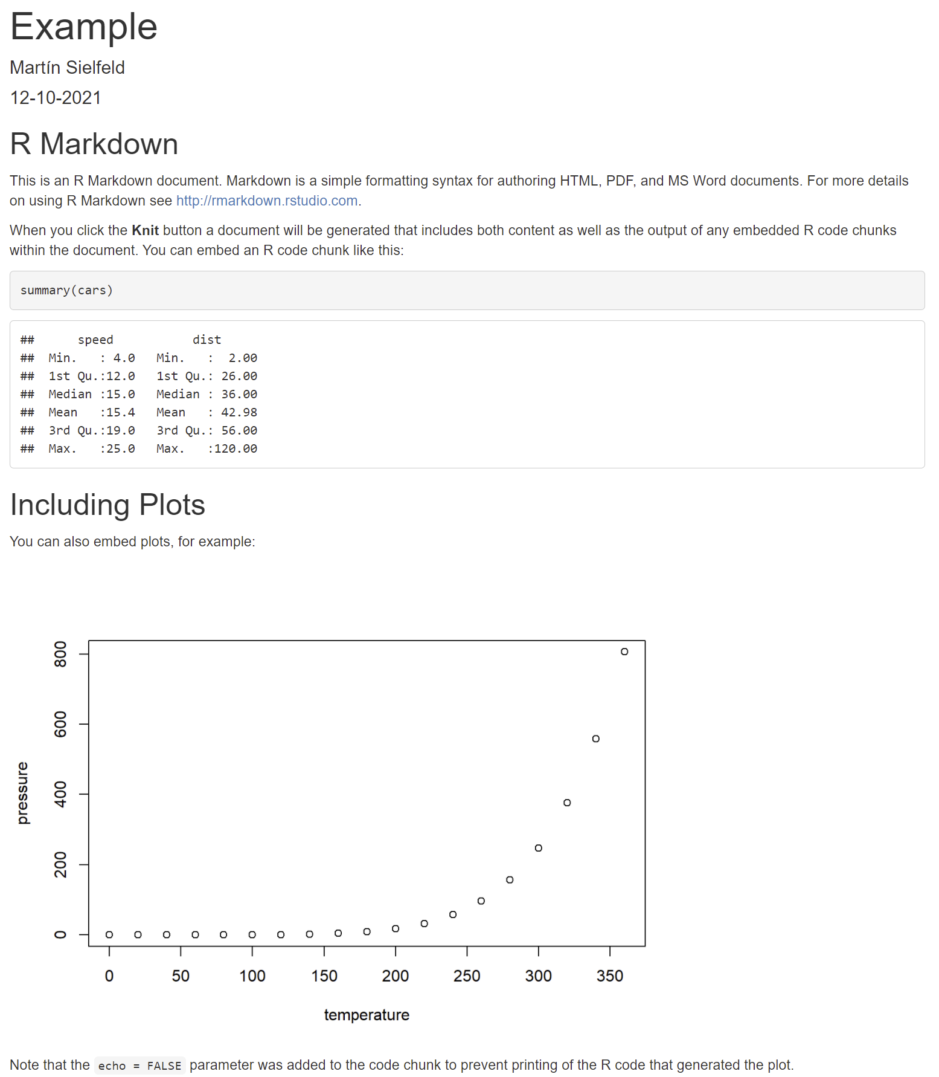
Rmarkdown
RStudio support markdown files.
Has extra tools.
Allows for Word, PDF, HTML and PowerPoint outputs (among others).
Allows to upload HTML files to websites (RPubs or own webpage).

Slide 14
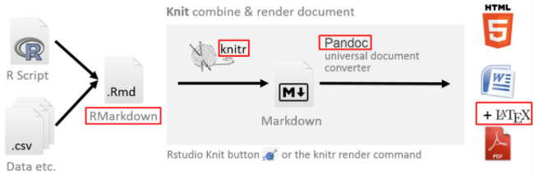
Rmarkdown

Slide 15
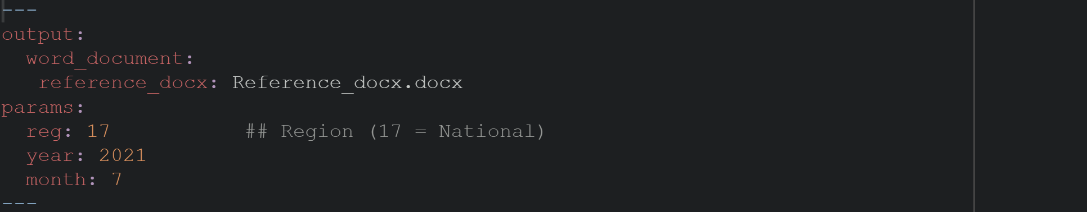
Structure
YAML header (Yet another Markup Language):
Output type (word, HTML, PDF, among others)
Title
Author
Other parameters (these are the ones that allow us automatize)

Slide 16
Structure
Chunks of code
Plots
Tables
Scripts

Slide 17
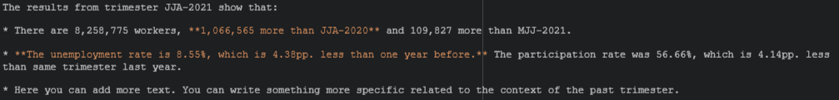
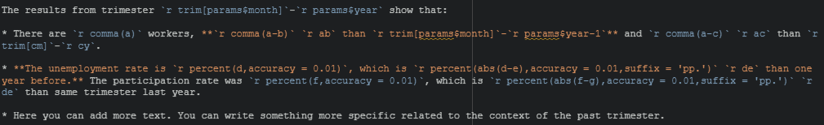
Structure
Text:
Pictures and tables
Links and footnotes.
Code

Slide 18
Example

Slide 19
Labor bulletin
My personal experience with report automation:
Working with monthly-frequency data.
It was necessary to send a report of each region (6) to the researchers whiting a one-hour interval.
Needed to prepare plots and tables for different topics each month.
Upload finished bulletins to webpage.

Slide 20
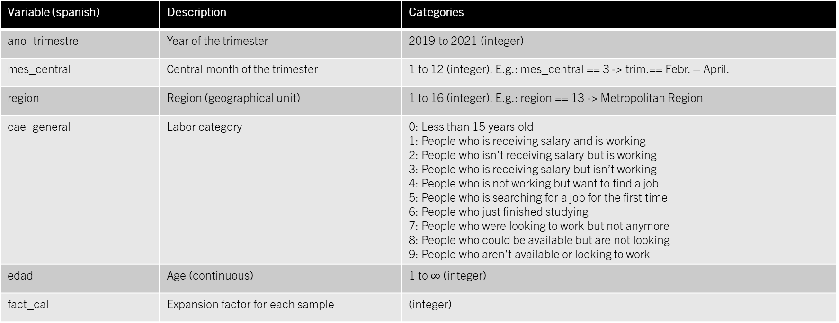
Labor bulletin
To help you understand the code:
Variable (spanish) | Description | Categories
ano_trimestre | Year of the trimester | 2019 to 2021 (integer)
mes_central | Central month of the trimester | 1 to 12 (integer). E.g.: mes_central == 3 -> trim.== Febr. – April.
region | Region (geographical unit) | 1 to 16 (integer). E.g.: region == 13 -> Metropolitan Region
cae_general | Labor category | 0: Less than 15 years old 1: People who is receiving salary and is working 2: People who isn’t receiving salary but is working 3: People who is receiving salary but isn’t working 4: People who is not working but want to find a job 5: People who is searching for a job for the first time 6: People who just finished studying 7: People who were looking to work but not anymore 8: People who could be available but are not looking 9: People who aren’t available or looking to work
edad | Age (continuous) | 1 to $∞$ (integer)
fact_cal | Expansion factor for each sample | (integer)

Slide 21
Folders
All the data and codes are available in my GitHub account.
R_workshops > 001 REPORT AUTOMATION:
Example 01: Rmarkdown file that is not automated.
Example 02: Rmarkdown file that is automated.
Labor data: folders with datasets of the Chilean labor market (monthly frequency).
Scripts for bulletin: scripts to use in example 02.
Reference_docx: reference document to use in example 02 for the Word output.

Slide 22
thanks

